Slide 1
Part 1: Python basic

Slide 2
CONTENTS
2
Part 1: Python basics
Getting Started with Jupyter Notebook
Variables and simple data types
Introducing lists, Tuples, Sets and Dictionaries
Conditional Statements and while loops
Function and class (OPP)

Slide 3
Outline
2. Variables and fundamental data types
Variables
String
Numbers
Boolean
Checking the type and Converting Data Types
Get user input

Slide 4
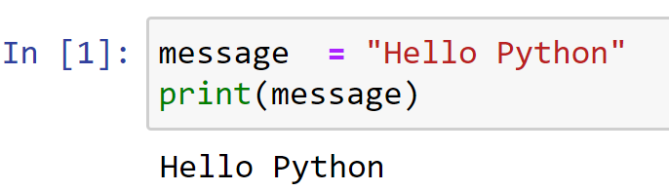
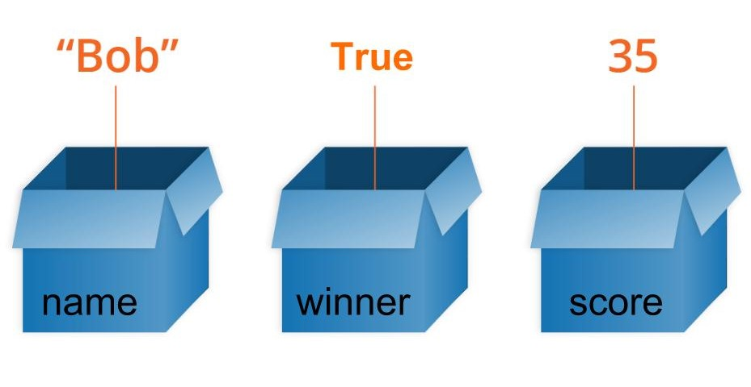
Variables
What happens when you run this code
Variables are used to store values

Slide 5
Variables
Naming and Using Variables
A few rules:
Variable names can contain only letters, numbers, and underscores.
Spaces are not allowed in variable names, but underscores can be used to separate words in variable names.
Avoid using Python keywords and function names as variable names; that is, do not use words that Python has reserved for a particular programmatic purpose, such as the word print.
Variable names should be short but descriptive.
Be careful when using the lowercase letter l and the uppercase letter O because they could be confused with the numbers 1 and 0.

Slide 6
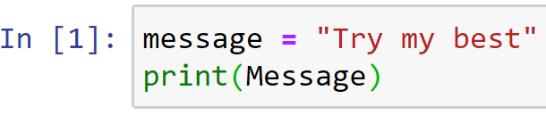
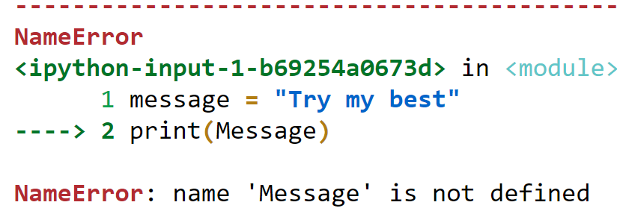
Variables
NOTE
The Python variables you’re using at this point should be lowercase. You won’t get errors if you use uppercase letters, but uppercase letters in variable names have special meanings that we’ll discuss in later chapters.
Avoiding Name Errors When Using Variables

Slide 7
Variables
Variables Are Labels
Variables are often described as boxes you can store values in
It’s much better to think of variables as labels that you can assign to values .
x
y
z
“Hello Python”
61
True
“DSEB”
62
x = “Hello Python”
y = 61
z = True
x = “DSEB”
y += 1

Slide 8
Practice
2-1, 2-2

Slide 9
Strings
A string is a series of characters. Anything inside quotes (single or double ) is considered a string in Python
Example:
“This is a string”
‘This is also a string’
'I told my friend, "Python is my favorite language!“’
"The language 'Python' is named after Monty Python, not the snake.“
"One of Python's strengths is its diverse and supportive community."

Slide 10
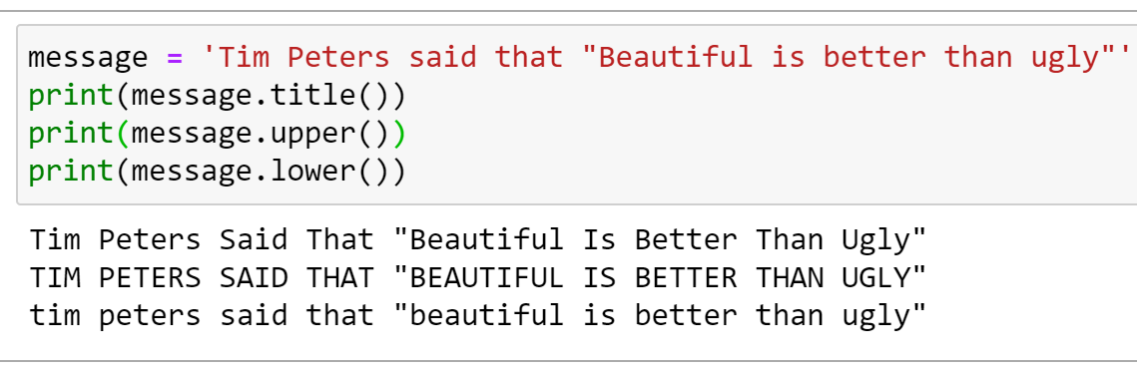
Strings
Changing Case in a String with Methods

Slide 11
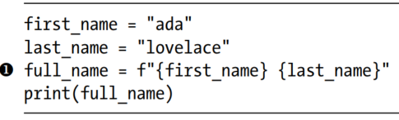
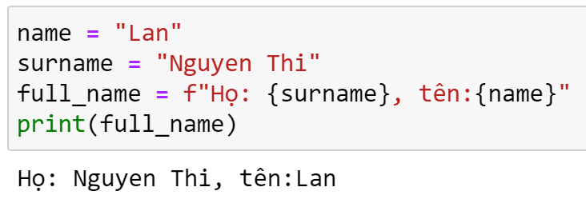
Strings
Using Variables in Strings

Slide 12
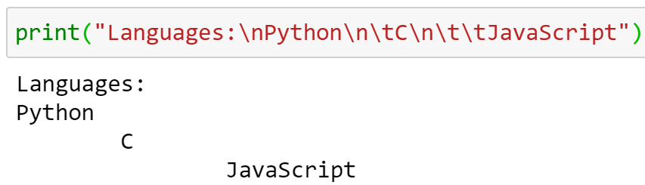
Strings
Adding Whitespace to Strings with Tabs or Newlines
\n: newlines
\t: tabs

Slide 13
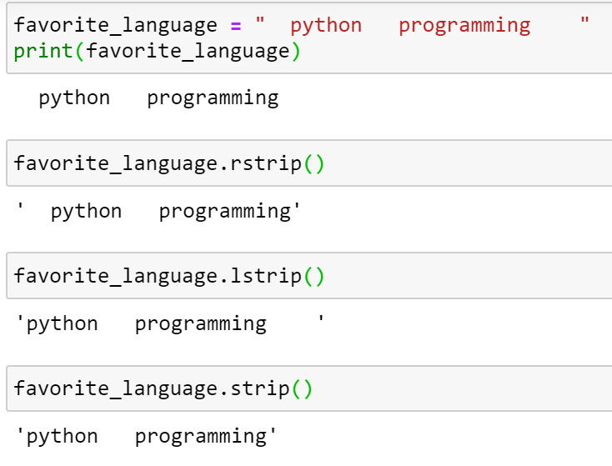
Strings
Stripping Whitespace
rstrip():remove the extra space from the right side
lstrip(): remove the extra space from the left side
strip(): remove the extra space from both sides

Slide 14
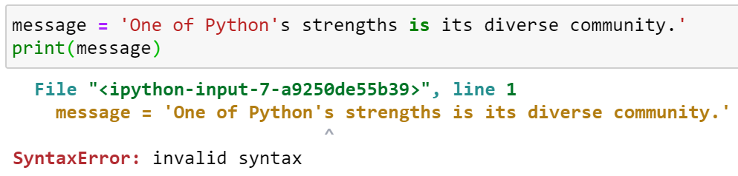
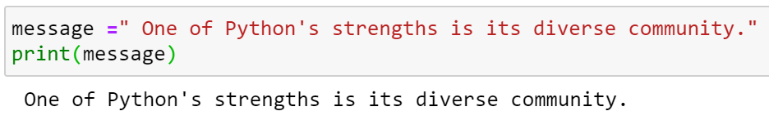
Strings
Avoiding Syntax Errors with Strings

Slide 15
Practice
2-3,…, 2.7

Slide 16

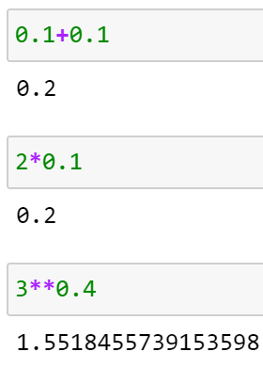
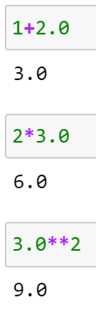
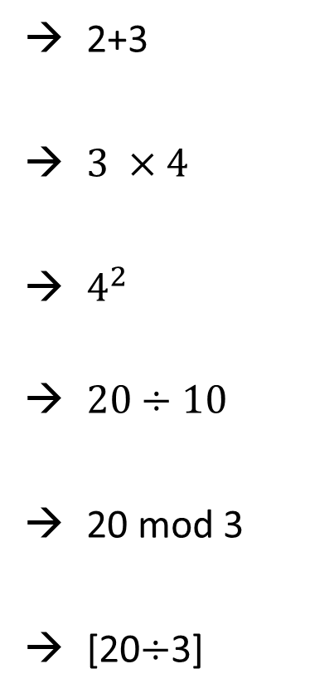
Numbers
Integers
Floats
Integers and Floats
2+3
$3 ×4$
$4^{2}$
$20÷10$
20 mod 3
[20$÷$3]

Slide 17
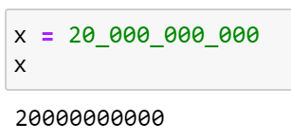
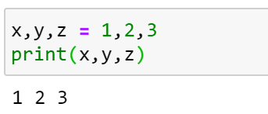

Numbers
Underscores in Numbers
Constants
A constant is like a variable whose value stays the same throughout the life of a program
Python doesn’t have built-in constant types, but Python programmers use all capital letters to indicate a variable should be treated as a constant and never be changed
Multiple Assignment

Slide 18
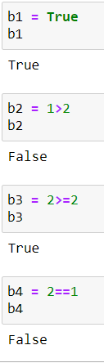


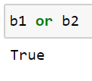
Boolean
Booleans is a binary variable, having two possible values True or False.
Logical Operator
Logical not: True if operand is false
Logical and: True if both the operands are true
Logical or: True if either of the operands is true

Slide 19
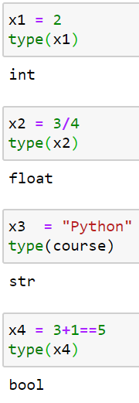
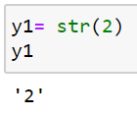
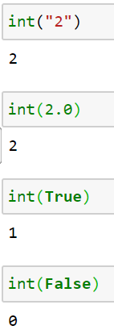
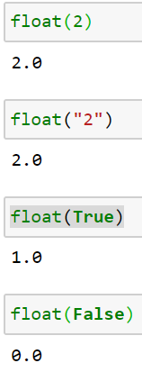
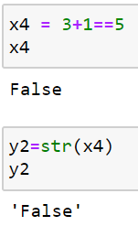
Checking the type and Converting Data Types
type()
str()
int()
float()

Slide 20
Practice
2-8, 2-9

Slide 21
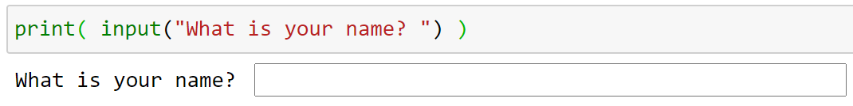
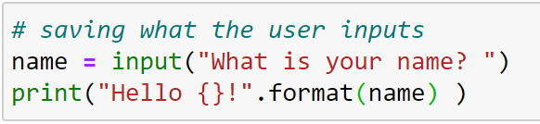
Get user input
input() function:
Like the print() function, input will print the string inside of the parenthesis.
But it will also create a box for the user to enter information.
Storing User Input

Slide 22
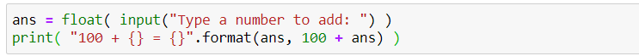
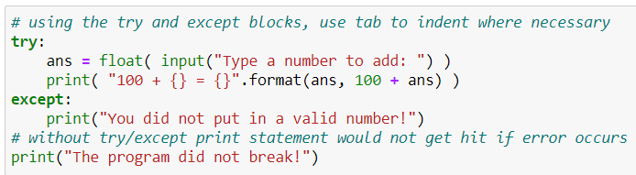
Get user input
Converting User Input
Handling Errors : try and except blocks

Slide 23
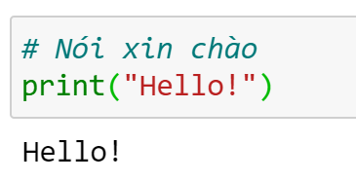
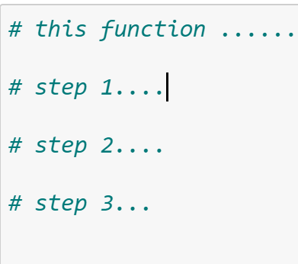
Comment
How Do You Write Comments?
What Kind of Comments Should You Write?

Slide 24
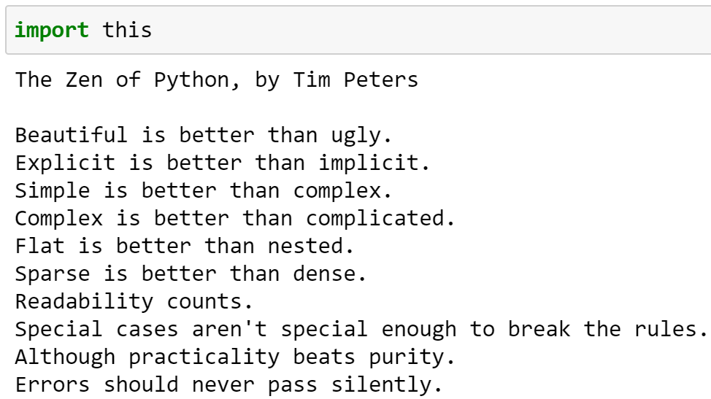
The Zen of Python
The Python community’s philosophy is contained in “The Zen of Python” by Tim Peters.

